Slide 1
Computer Network
Introduction

Slide 2
Course contents
Objective: To be familiar with the basic of data communication, various types of computer network desinging communication protocol and exposed to the TCP/IP protocol Suit.
1.Introduction to computer Networks(4 hrs)
2. Local Area Networks (4 hrs)
3. Transmission and Channel control: Physical Layer( 5 hrs)
4.Data link layer and Medium access sub layer( 5 hrs)
5. Internetworking ( 9 hrs)
6. Overview of TCP/IP ( 10 hrs)
7. Delivering the Data ( 4 hrs)
8. Properties of secure communication ( 4 hrs)

Slide 3
Computer Network
Computer Networks is an information technology topic that includes computer network standards, media and topologies, devices, services, security, management, and troubleshooting.
An interconnected collection of autonomous computers.
Two computers are said to be interconnected if they are able to exchange information.
A system with one control unit and many slaves is not a network.

Slide 4
Components of a Network
A minimum of at least 2 computers
Cables that connect the computers to each other, although wireless
A network interface device on each computer
(network interface card or NIC)
A ‘Switch’ used to switch the data from one point to another. Hubs are outdated and are little used for new installations.
Network operating system software

Slide 5
Benefits of a computer network
File sharing: Networking of computers helps the network users to share data files.
Hardware sharing: Users can share devices such as printers, scanners, CD-ROM drives, hard drives etc. Without computer networks, device sharing is not possible.
Application sharing: Applications can be shared over the network, and this allows to implement client/server applications
User communication: Networks allow users to communicate using e-mail, newsgroups, and video conferencing etc.
Network gaming: A lot of network games are available, which allow multi-users to play from different locations.
Voice over IP (VoIP): Voice over Internet Protocol (IP) is a revolutionary change in telecommunication which allows to send telephone calls (voice data) using standard Internet Protocol (IP) rather than by traditional PSTN.

Slide 6
Advantages of Computer Networking
1. It enhances communication and availability of information.
Networking, especially with full access to the web, allows ways of communication that would simply be impossible before it was developed. Instant messaging can now allow users to talk in real time and send files to other people wherever they are in the world, which is a huge boon for businesses. Also, it allows access to a vast amount of useful information, including traditional reference materials and timely facts, such as news and current events.
2. It allows for more convenient resource sharing.
Particularly for larger companies that really need to produce huge numbers of resources to be shared to all the people. Since the technology involves computer-based work, it is assured that the resources they wanted to get across would be completely shared by connecting to a computer network which their audience is also using.
3. It makes file sharing easier.
Computer networking allows easier accessibility for people to share their files, which greatly helps them with saving more time and effort, since they could do file sharing more accordingly and effectively.

Slide 7
Advantages of Computer network
4. It is highly flexible.
As it gives users the opportunity to explore everything about essential things, such as software without affecting their functionality. Plus, people will have the accessibility to all information they need to get and share.
5. It is an inexpensive system.
Installing networking software on your device would not cost too much, as you are assured that it lasts and can effectively share information to your peers. Also, there is no need to change the software regularly, as mostly it is not required to do so.
6. It increases cost efficiency.
With computer networking, you can use a lot of software products available on the market which can just be stored or installed in your system or server, and can then be used by various workstations.
7. It boosts storage capacity.
Since you are going to share information, files and resources to other people, you have to ensure all data and content are properly stored in the system. With this networking technology, you can do all of this without any hassle, while having all the space you need for storage.

Slide 8
Disadvantages of Computer Networking
1. It lacks independence.
Computer networking involves a process that is operated using computers, so people will be relying more of computer work, instead of exerting an effort for their tasks at hand. Aside from this, they will be dependent on the main file server, which means that, if it breaks down, the system would become useless, making users idle.
2. It poses security difficulties.
Because there would be a huge number of people who would be using a computer network to get and share some of their files and resources, a certain user’s security would be always at risk. There might even be illegal activities that would occur, which you need to be careful about and aware of.
3. It lacks robustness.
As previously stated, if a computer network’s main server breaks down, the entire system would become useless. Also, if it has a bridging device or a central linking server that fails, the entire network would also come to a standstill. To deal with these problems, huge networks should have a powerful computer to serve as file server to make setting up and maintaining the network easier.
4. It allows for more presence of computer viruses and malware.
There would be instances that stored files are corrupt due to computer viruses. Thus, network administrators should conduct regular check-ups on the system, and the stored files at the same time.

Slide 9
Disadvantages.........
5. Its light policing usage promotes negative acts.
It has been observed that providing users with internet connectivity has fostered undesirable behavior among them. Considering that the web is a minefield of distractions—online games, humor sites and even porn sites—workers could be tempted during their work hours. The huge network of machines could also encourage them to engage in illicit practices, such as instant messaging and file sharing, instead of working on work-related matters. While many organizations draw up certain policies on this, they have proven difficult to enforce and even engendered resentment from employees.
6. It requires an efficient handler.
For a computer network to work efficiently and optimally, it requires high technical skills and know-how of its operations and administration. A person just having basic skills cannot do this job. Take note that the responsibility to handle such a system is high, as allotting permissions and passwords can be daunting. Similarly, network configuration and connection is very tedious and cannot be done by an average technician who does not have advanced knowledge.
7. It requires an expensive set-up.
Though computer networks are said to be an inexpensive system when it is already running, its initial set up cost can still be high depending on the number of computers to be connected. Expensive devices, such as routers, switches, hubs, etc., can add up to the cost. Aside from these, it would also need network interface cards (NICs) for workstations in case they are not built in.

Slide 10
A Communications Model
Source
  Generates data to be transmitted
Transmitter
  Converts data into transmittable signals
Transmission system
  Carries data
Receiver
  Converts received signal into data
Destination
  Takes incoming data

Slide 11
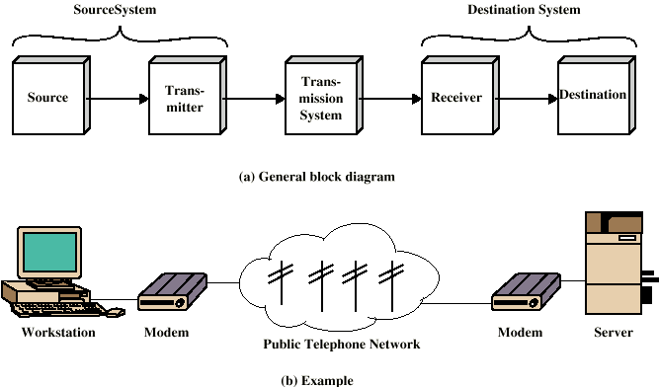
Simplified Communications Model - Diagram

Slide 12
Key Communications Tasks
Transmission system utilization
Interfacing
Signal generation
Synchronization
Exchange management
Error detection and correction
Addressing and routing
Recovery
Message formatting
Security
Network management

Slide 13
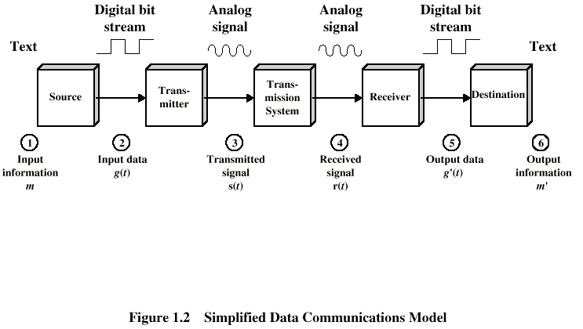
Simplified Data Communications Model

Slide 14
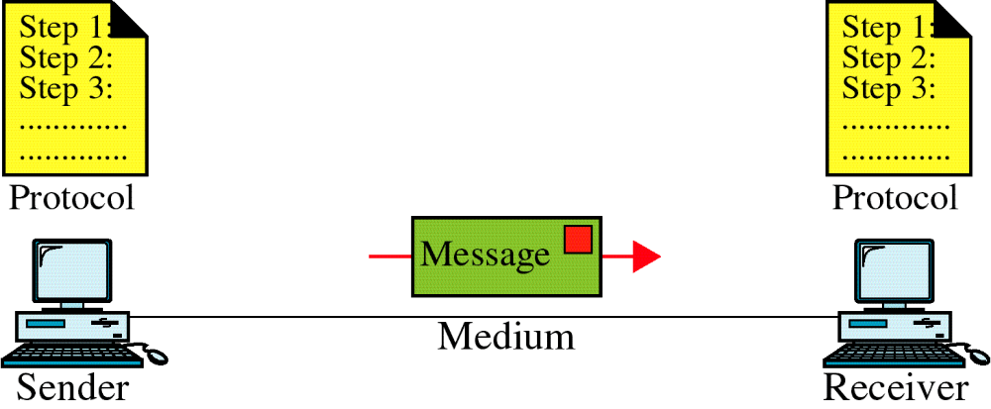
Data Communication System Components

Slide 15
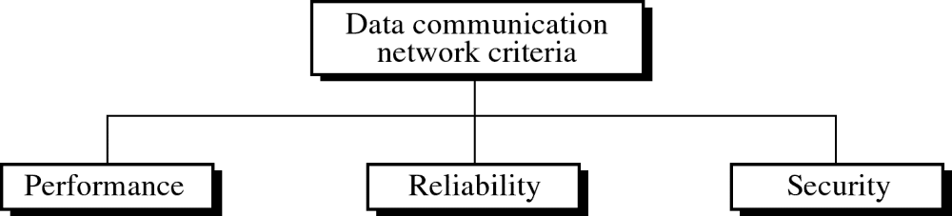

Slide 16
Network Criteria
Performance:
- transit time (device to device)
response time (enquiry to response)
Throughput
delay
Reliability :
-Failure rate of network components
- Measured in terms of availability/robustness
Security :
-Data protection against corruption/loss of data due to:
- Errors
- Malicious users

Slide 17
Network Topology
Network Topology is the study of the arrangement or mapping of the elements (links, nodes, etc.) of a network interconnection between the nodes.
Topologies can be physical or logical.
Physical Topology means the physical design of a network including the devices, location and cable installation.
Logical Topology refers to the fact that how data actually transfers in a network as opposed to its design.

Slide 18
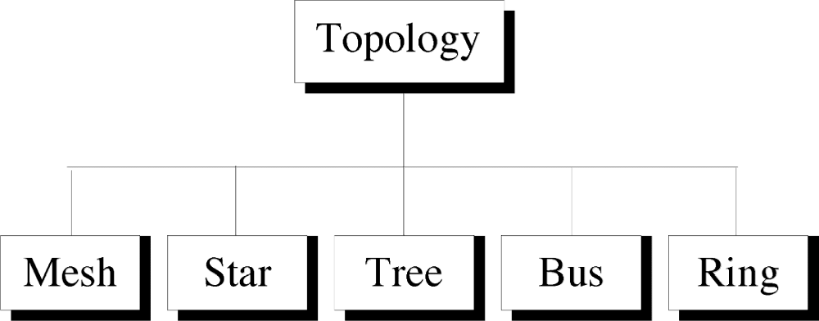

Slide 19
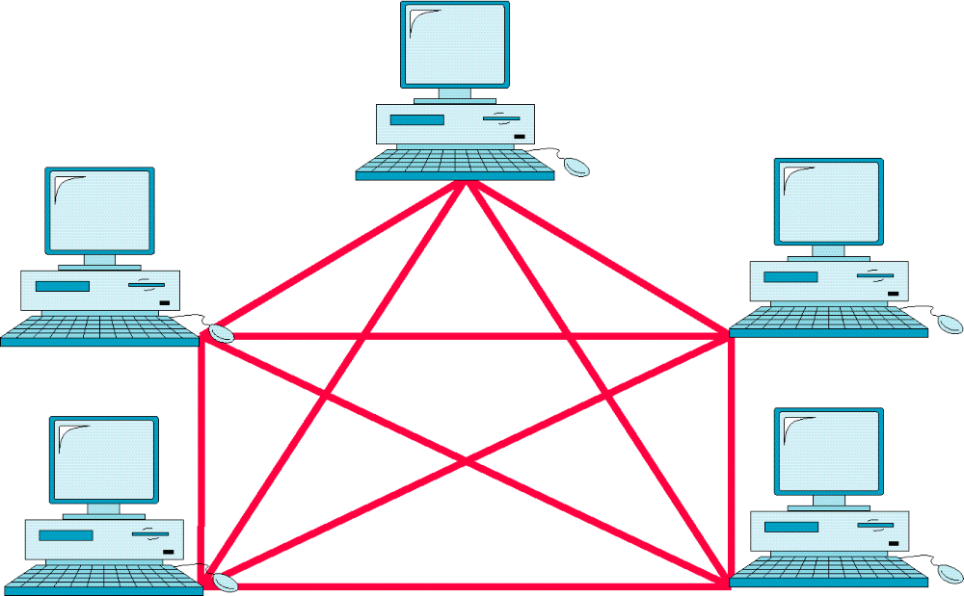
Mesh Topology

Slide 20
Mesh Topology
Devices are connected with many redundant interconnections between network nodes. In a well-connected topology, every node has a connection to every other node in the network. The cable requirements are high, but there are redundant paths built in.
Failure in one of the computers does not cause the network to break down, as they have alternative paths to other computers. Mesh topologies are used in critical connection of host computers (typically telephone exchanges). Alternate paths allow each computer to balance the load to other computer systems in the network by using more than one of the connection paths available.
A fully connected mesh network therefore has no (n-1) /2 physical channels to link n devices. To accommodate these, every device on the network must have (n-1) input/output ports.

Slide 21
Advantages
Yield the greatest amount of redundancy in the event that one of the nodes fails where network traffic can be redirected to another node.
Point-to-point link makes fault isolation easy.
Privacy between computers is maintained as messages travel along dedicated path.
Network problems are easier to diagnose.

Slide 22
Disadvantages
The amount of cabling required is high.
A large number of I/O (input/output) ports are required.

Slide 23
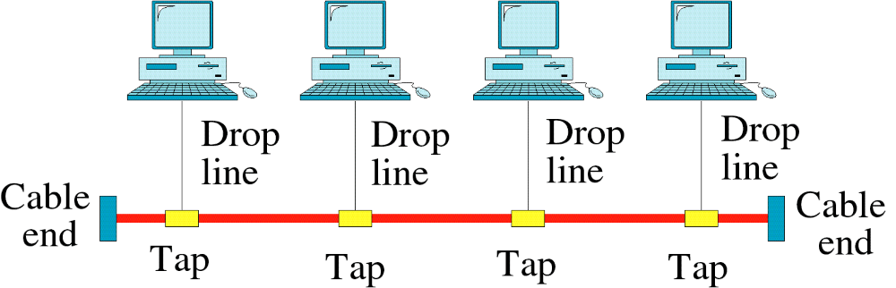
Bus Topology

Slide 24
BUS Topology
Single network cable runs in the building or campus and all nodes are linked along with this communication line with two endpoints called the bus or backbone.
By this type of topology, if one node goes faulty all nodes may be affected as all nodes share the same cable for the sending and receiving of information.
The cabling cost of bus systems is the least of all the different topologies. Each end of the cable is terminated using a special terminator.

Slide 25
Advantages:
Reliable in very small networks as well as easy to use and understand.
Requires least amount of cable to connect the computers (nodes) together and therefore is less expensive than other cabling arrangements.
It's easy to extend, Two cables can be easily joined with a connector, making a longer cable for more computers to join the network.
A repeater can also be used to extend a bus configuration.

Slide 26
Disadvantages:
Heavy network traffic can slow a bus considerably because any computer can transmit at any time. But networks do not
Coordinate when information is sent. Computer interrupting each other can use a lot of bandwidth.
Each connection between two cables weakens the electrical signal.
The bus configuration can be difficult to find and can cause the whole networks to stop functioning.

Slide 27
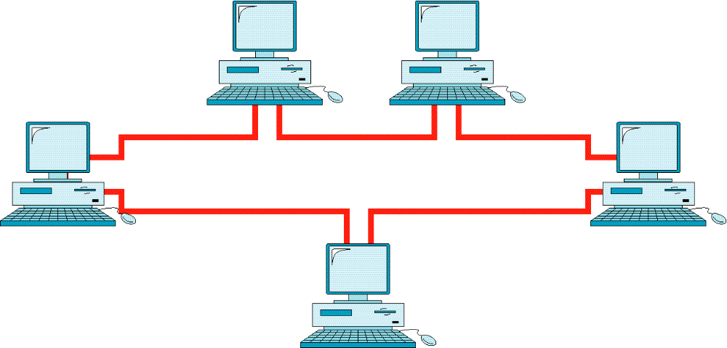
Ring Topology

Slide 28
The network cable passes from one node to another until all nodes are connected in the form of a loop or ring. There is a direct point-to-point link between two neighboring nodes (the Next and the Previous). These links are unidirectional which ensures that transmission by a node traverses the whole ring and comes back to the node,
Information travels around the ring from one node to the next. Each packet of data sent to the rink is prefixed by the address of the station to which it is being sent. When a packet of data arrives, the node checks to see if the packet address is the same as its own, if it is, it grabs the data in the packet. If the packet does not belong to it, it sends the packet to the next node in the ring.
Faulty nodes can be isolated from the ring. When the workstation is powered on, it connects itself to the ring. When power is off, it disconnects itself from the ring and allows the information to bypass the node.
The most common implementation of this topology is token ring. A break in the ring causes the entire network to fail. Individual nodes can be isolated from the ring.

Slide 29
Advantages:
Ring networks offer high performance for a small number of workstations or for larger networks where each station has a similar workload.
Ring networks can span longer distances than other types of networks.
Ring networks are easily extendable.
Unlike Bus topology, there is no signal loss in Ring topology because the tokens are data packets that are re-generated at each node.

Slide 30
Disadvantages:
Relatively expensive and difficult to install
Failure of one computer on the network can affect the whole network.
It is difficult to find fault in a ring network.
Adding or removing computers can disrupt the network.
It is much slower than an Ethernet network under normal load.

Slide 31
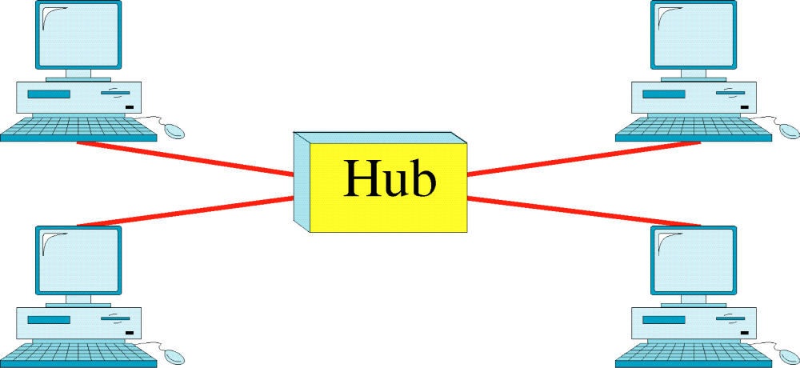
Star Topology

Slide 32
Star topology uses a central hub through which, all components are connected. In a Star topology, the central hub is the host computer, and at the end of each connection is a terminal .
Nodes communicate across the network by passing data through the hub. A star network uses a significant amount of cable as each terminal is wired back to the central hub, even if two terminals are side by side but several hundred meters away from the host. The central hub makes all routing decisions, and all other workstations can be simple.
An advantage of the star topology is that failure, in one of the terminals does not affect any other terminal; however, failure of the central hub affects all terminals. This type of topology is frequently used to connect terminals to a large time-sharing host computer.

Slide 33
Advantages: Star
It is more reliable (if one connection fails, it does not affect others)
The center of a star network is a good place to diagnose network faults and if one computer fails whole network is not disturbed. Hub detects the fault and isolates the faulty computer.
It is easy to replace, install or remove hosts or other devices, the problem can be easily detected-It is easier to modify or add a new computer without disturbing the rest of the network by simply running a new line from the computer to the central location and plugging it to the hub.
Use of multiple cable types in a same network with a hub.
It has good performance

Slide 34
Disadvantages: Star
It is expensive to install as it requires more cable, it costs more to cable a star network because all network cables must be pulled to one central point, requiring more cable length than other networking topologies.
Central node dependency, if central hub fails, the whole network fails to operate.
Many star networks require a device at the central point to rebroadcast or switch the network traffic.

Slide 35
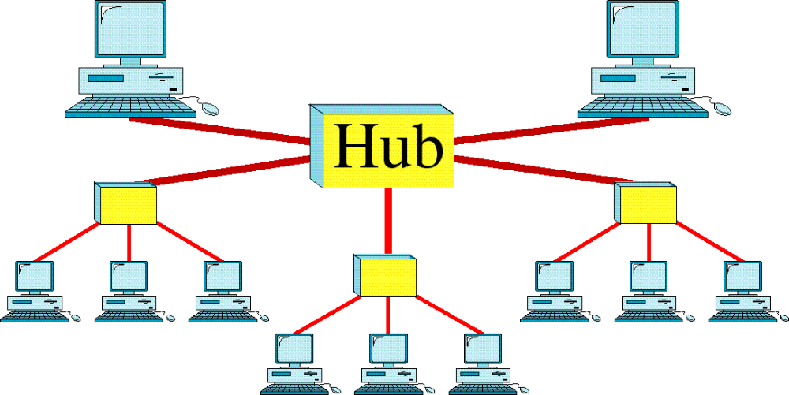
Tree Topology

Slide 36
Tree
Tree topology is a LAN topology in which only one route exists between any two nodes on the network. The pattern of connection resembles a tree in which all branches spring from one root.
Tree topology is a hybrid topology, it is similar to the star topology but the nodes are connected to the secondary hub, which in turn is connected to the central hub. In this topology group of star-configured networks are connected to a linear bus backbone.

Slide 37
Advantages
Installation and configuration of network are easy.
The addition of the secondary hub allows more devices to be attached to the central hub.
Less expensive when compared to mesh topology.
Faults in the network can be detected traces.

Slide 38
Disadvantages
Failure in the central hub brings the entire network to a halt.
More cabling is required when compared to the bus topology because each node is connected to the central hub.

Slide 39
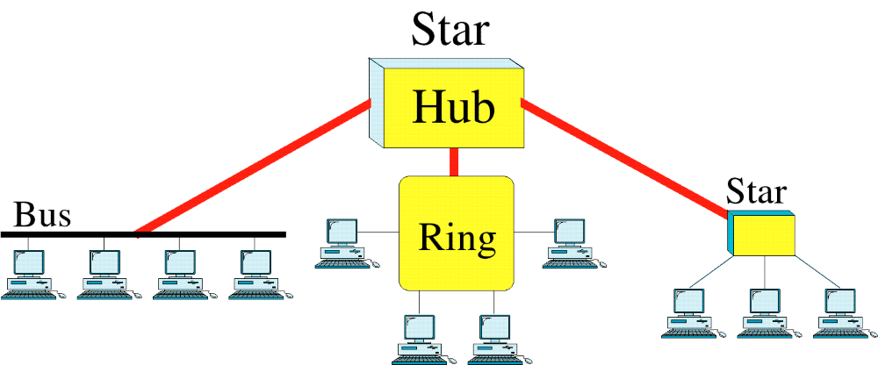
Hybrid Topology

Slide 40
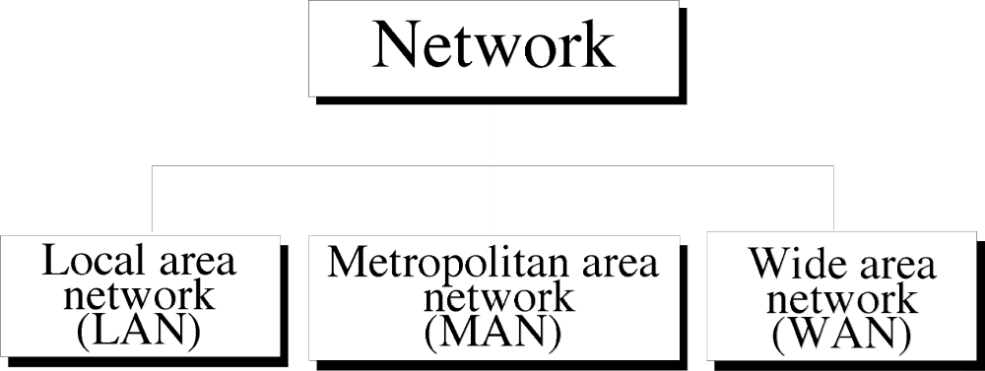

Slide 41
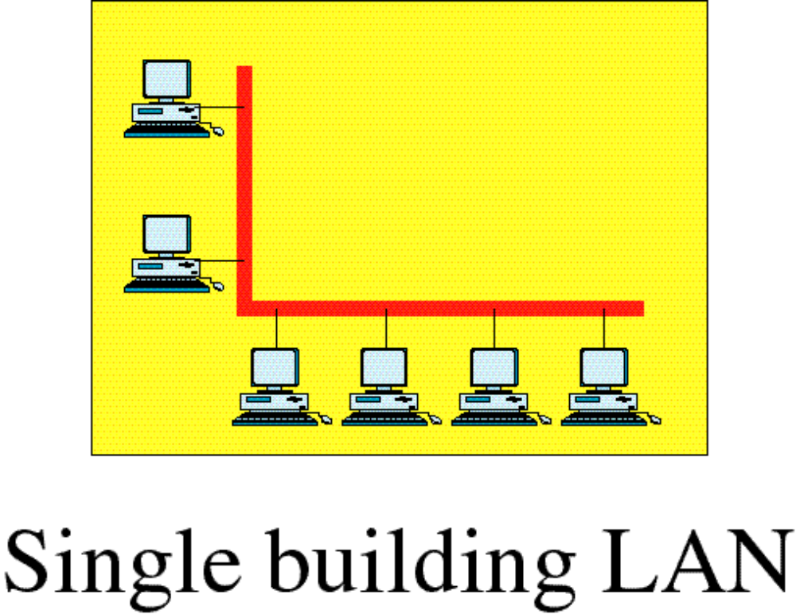
Local Area Network

Slide 42
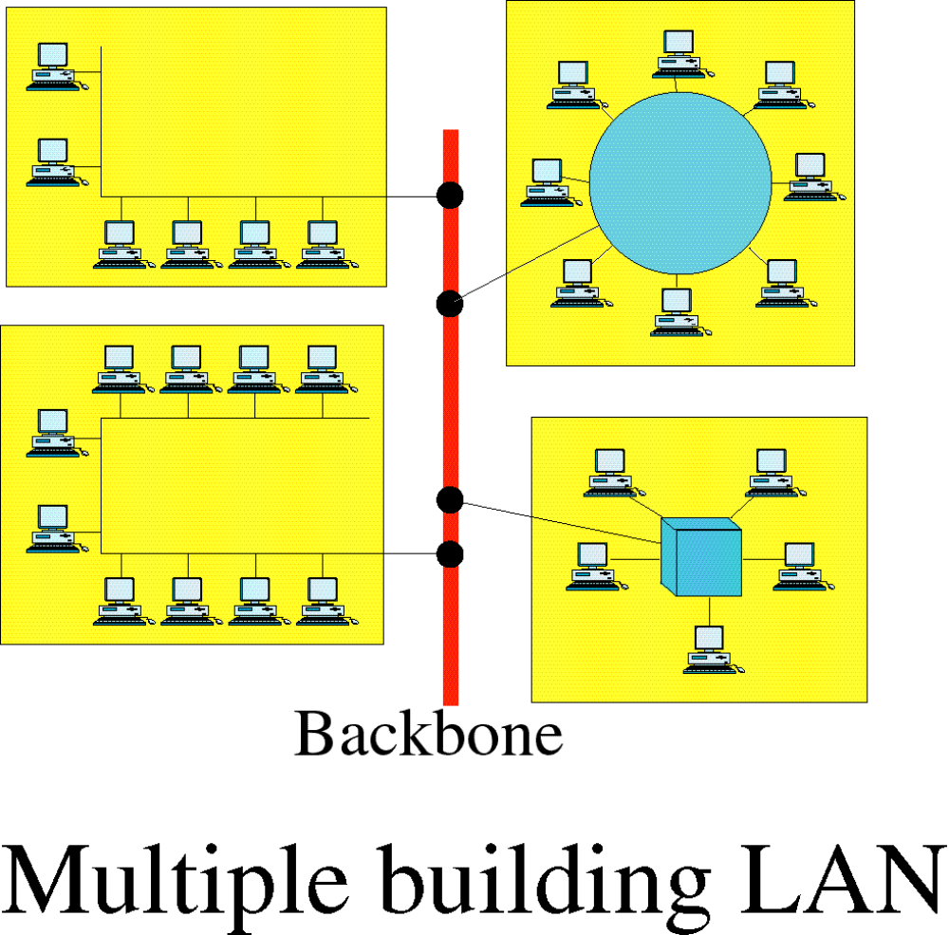
Local Area Network

Slide 43
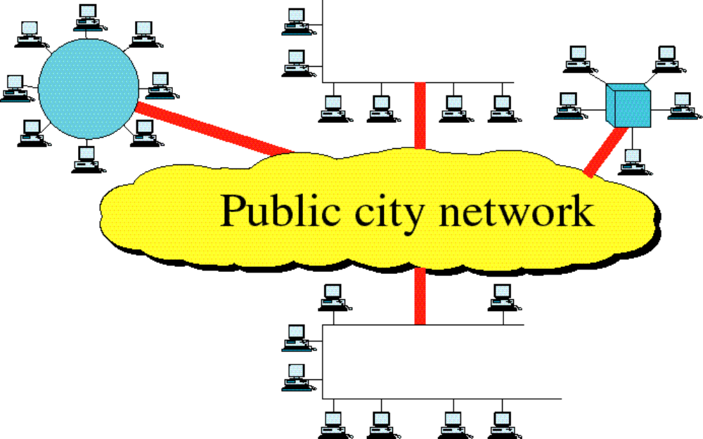
Metropolitan Area Network

Slide 44
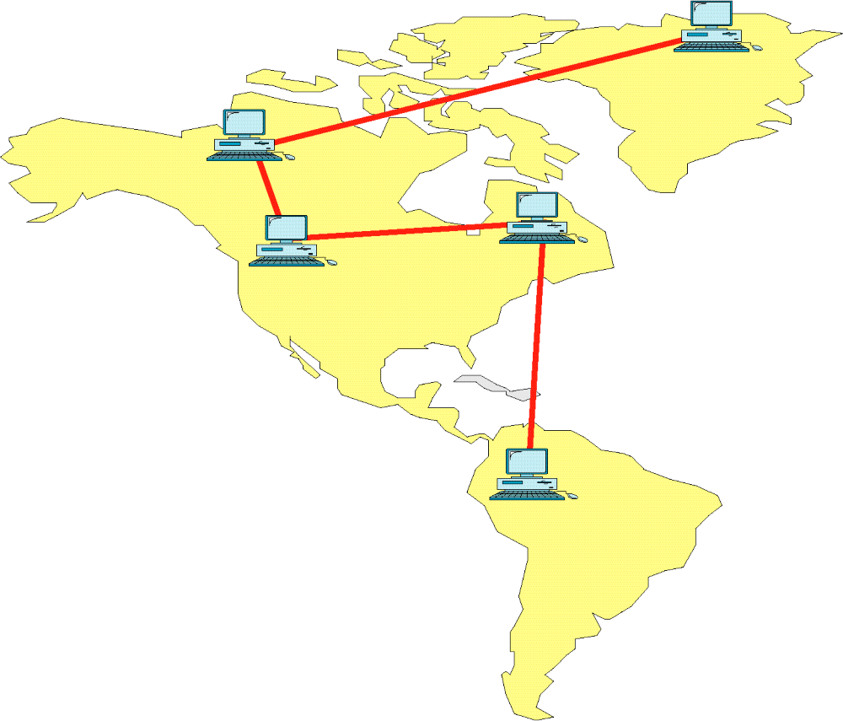
Wide Area Network

Slide 45
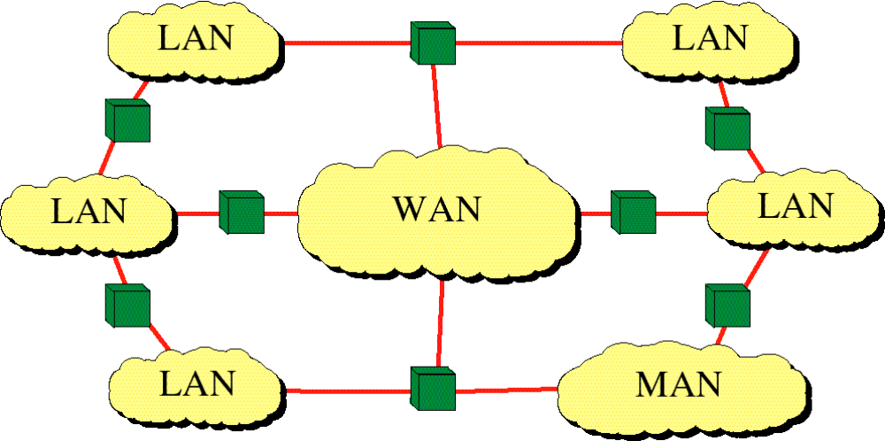
Internetwork
(Internet)

Slide 46
Local Area Networks
Smaller scope
  Building or small campus
Usually owned by same organization as attached devices
Data rates much higher
Usually broadcast systems
Now some switched systems and ATM are being introduced

Slide 47
Local Area Networks (Cont.)
NETWORKS
LAN
MAN
WAN
INTERNET
LAN CHARACTERISTICS
Size
Transmission Technology
Topology
Restricted in Size
Single Cable
10 to 100 Mbps
Low delay (ms)
Very few Errors
Megabits/Sec. (Unit)
BUS (Ethernet)
Ring (Token ring)

Slide 48
MAN
Metropolitan Area Network
Support data and voice
No switching elements
Standard: DQDB
(Distributed Queue Dual Bus)
Two unidirectional buses to which all the computers are connected.
Each bus has a head-end, a device that initiates transmission activity.
Traffic that is destined for a computer to the right of the sender uses the upper bus, traffics to the left uses the lower one.

Slide 49
Wide Area Networks
Large geographical area
Crossing public rights of way
Rely in part on common carrier circuits
Alternative technologies
  Circuit switching
  Packet switching
  Frame relay
  Asynchronous transfer mode (ATM)

Slide 50
Wide Area Networks (Cont.)
Host (end system).
Subnet (communication subnet).
WANs typically have irregular topologies.
WAN CONSISTS OF
Transmission Lines:- Circuits, Channels or Tanks
Switching Elements:- Specialized computers used to connect two or more transmission lines.

Slide 51
Internet
Collection of interconnected networks.
Example: A collection of LAN’s connected by a WAN.
WAN : (router + hosts).
SUBNET : (only routers).

Slide 52
Connectionless Service
In a connectionless service, the packets are sent from one party to another with no need for connection establishment or connection release.
The packets are not numbered; they may be delayed or lost or may arrive out of sequence.
There is no acknowledgment either.
UDP(user datagram Protocol), is connectionless

Slide 53
Connection Oriented Service
In a connection-oriented service, a connection is first established between the sender and the receiver.
Data are transferred.
At the end, the connection is released
TCP and SCTP are connection-oriented protocols.

